Slide 1


POWER BI DASHBOARD SALES ANALYSIS
Task 3 – Data Analyst Internship
Name – TUSHAR
Date – 05/06/2025

Slide 2
OBJECTIVE
The objective of this task was to design an interactive and visually informative sales dashboard.

Slide 3
DATASET DESCRIPTION
Dataset: Superstore Sales Data (from Kaggle)
Main Columns Used:
- Order Date
- Sales
- Profit
- Category
- Region
Reason for Choosing: It contains complete sales and financial information suitable for building KPIs and charts

Slide 4
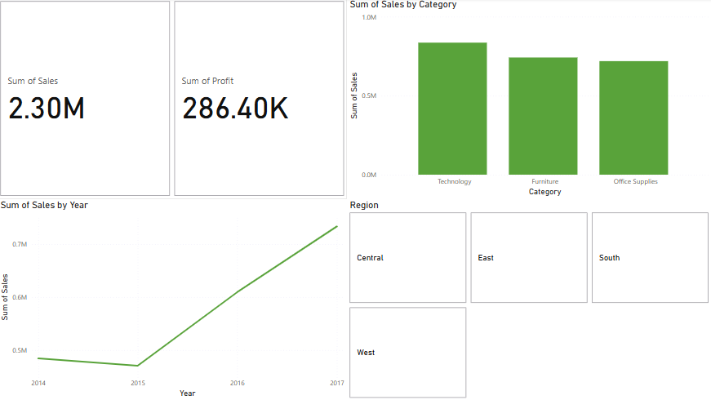
DASHBOARD OVERVIEW
This dashboard includes:
- KPIs: Total Sales and Profit
- Sales over Time (Line Chart)
- Sales by Category (Clustered Column Chart)
- Interactive Slicers: Region

Slide 5
KEY INSIGHT
Insights:
✅ Technology category generated the highest sales.
✅ Western Region performed the best in terms of profit.
✅ Sales peaked during the holiday season (Oct–Dec).
✅ Office Supplies had the lowest profit margin.

Slide 6
TOOLS USED
- Power BI Desktop
- Kaggle (for dataset)
- Microsoft PowerPoint
- GitHub (for submission)

